Slide 2
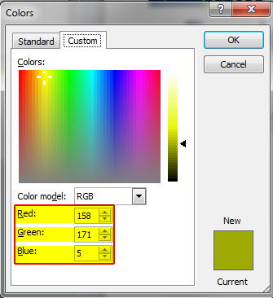
Georgia (italicized)
Century Gothic
Colors:
Green R:114 G:191 B:68
Blue R:0 G:2 B:46

