Slide 1
The Broken Diagrams

Slide 2
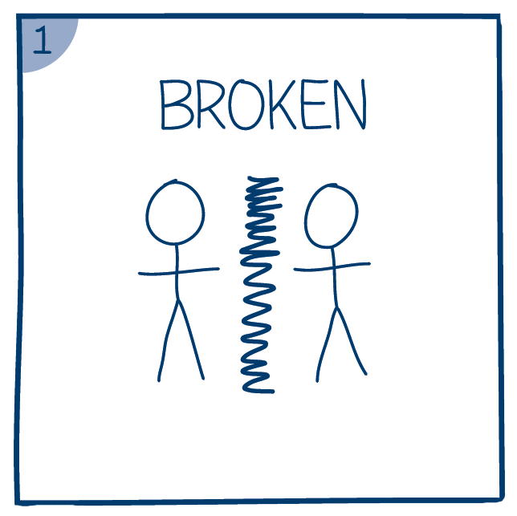

Slide 3
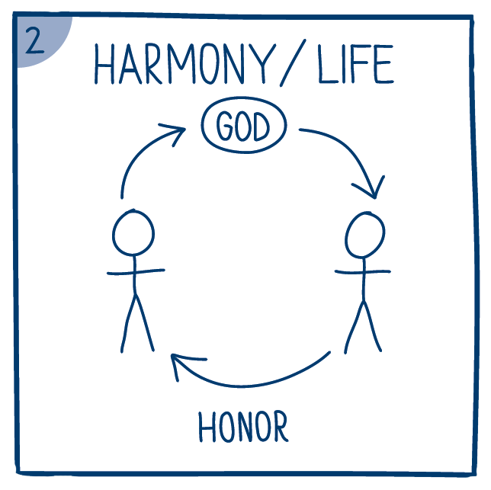

Slide 7
