Slide 1
Relationship
The Heart of the Universe

Slide 2
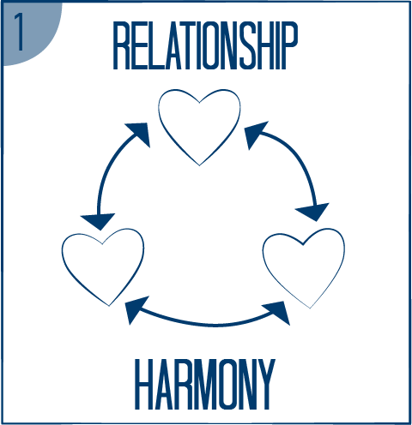
What relationships are important to you?
People of every culture long for relationships
God is love: a relationship of holy and harmonious love between Father, Son and Spirit
The universe holds together in this love
The Heart of the Universe
Father, Son and Holy Spirit

Slide 3
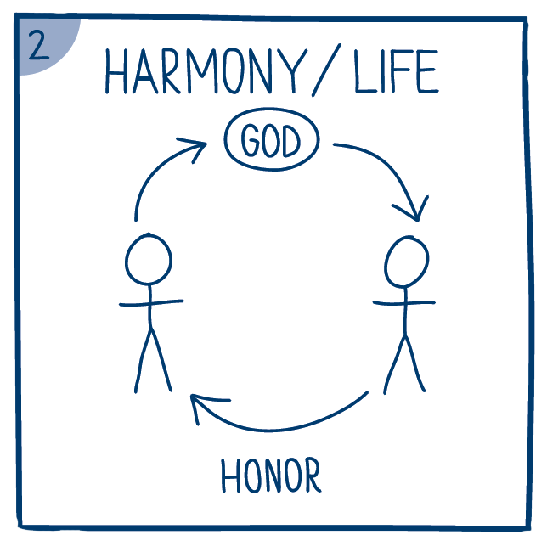
Relationship
Because God is love, he created humans in his image in order to love them
Relationship with God gave them life
God honored them by being in a face-to-face relationship with them
The first humans honored God, each other, themselves and the earth, living in perfect harmony
They were clothed with the honor or glory of God

Slide 4
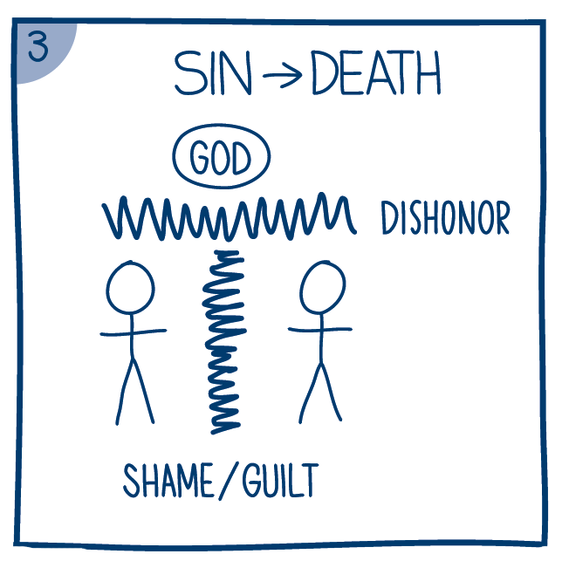
Sin
When the humans disobeyed and dishonored God, breaking relationship. harmony was lost
When the relationship with God was broken, honor was also lost, and they felt shame and guilt
Since then, humans keep dishonoring and breaking relationship with God and one another: sin
Sin is the heart attitude that puts self first and dishonors God and others

Slide 5

Jesus
Since humans were in a state of separation and death, they couldn’t restore their relationship with God on their own – only God could
God the Son, Jesus, became human to reunite his brothers and sisters with God the Father.
When he died on the cross, Jesus took on shame and guilt and honored the Father through obedience

Slide 6
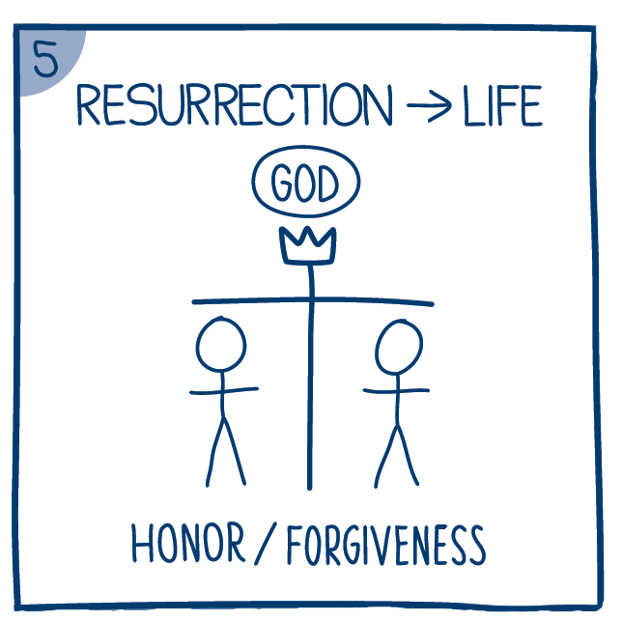
Resurrection
Jesus didn’t remain dead! The Father honored his obedience by bringing him back to life – resurrection
The crown represents the honor Jesus received in the resurrection
When we follow Jesus, his obedience is credited to us and our sin is forgiven. Jesus offers life, honor, and forgiveness to everyone who will follow him as Lord
What questions do you have?

Slide 7
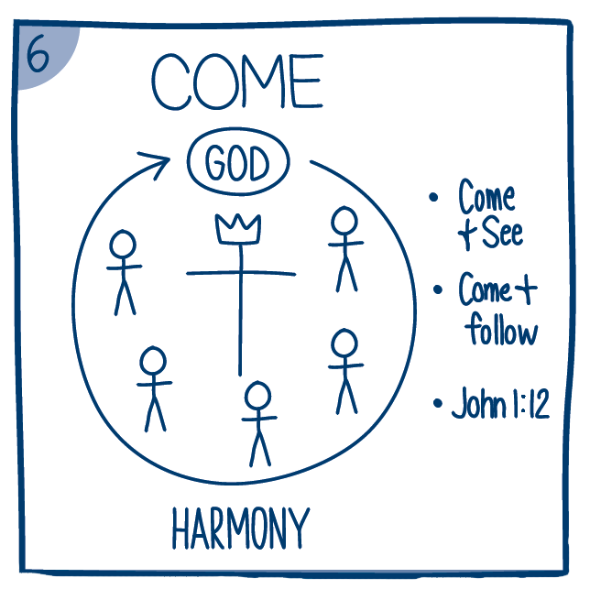
Come
Jesus’ followers are a worldwide family connected to God and one another working to bring harmony to broken relationships
Jesus offers two different invitations:
  Come and see
  come and follow

Slide 8
Come & See Come & Follow
Join Jesus and his family in bringing harmony to a broken world
John 1:12: “Yet to all who did receive him, to those who believed in his name, he gave the right to become children of God” (NIV)
“Receiving” means welcoming Jesus into your life as Lord
“Believing” means trusting in him deeply
Become a sincere seeker:
Learn to know Jesus through:
  Reading the Bible and praying
  Doing what Jesus teaches
  Spending time with his people

Slide 9
Invitations
Jesus is making these two invitations now
Are you ready to say yes to one of them or do you need some more time?
Come and See
Come and Follow

