Slide 1
Welcome
As you enter
Grab 2 post-its
Write the name of 2 international friends
Post it on their home country on the map
Notes:
While entering:
While entering, please grab a few post-its.
Write the name of 2 international friends
Post it on their home country in the front
(if you just came in, write at top of page)

Slide 2
Starting a
Cross Cultural Evangelistic Bible study
Notes:
Urbana Seminar Outline Starting Cross Cultural Evangelistic Bible Studies Brian Smith and Allison Schafer December 30th, 2012 2pm-3pm Hyatt Regency- Ballroom DEF Materials needed: Allison = Computer (A), Rutendo (A), open doors & tools print outs (A) - 150?, adam’s clicker, AAA batteries Brian = resources like IGIG (Brian), map of world (B), post-its , blue tape (B), print out 10 reasons (Brian), pieces of paper (B), you tube capabilities?

Slide 3
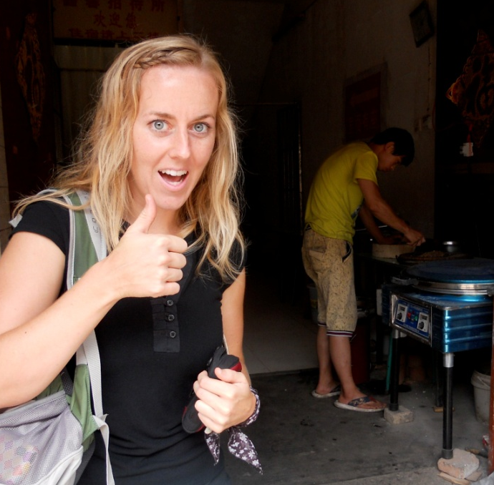
Welcome
About Allison
IVCF staff 7 years
International student in Spain
New favorite food – belt noodle
About Brian
IVCF staff 4 years
International student in Japan
Had a tiger in his basement
Notes:
2. Welcome (1)
About Allison -
IVCF 7 years staff, intl student in Spain, newly favorite food is 3 ft long belt noodle
About Brian -
IVCf Staff 4 years, Intl student in Japan, had a tiger in my basement

Slide 4
Where we’re going
Why international students?
Seeing Jesus through your friends’ perspective
Gaining practical tools how to start a cross cultural Bible study
Notes:
3. Road Map: Where we’re going - Allison
Why international students?
Seeing Jesus through your friends’ perspective
Gaining practical tools how to start cross cultural Bible study

Slide 5
Why International Students?
Notes:
Part 1 : Why Reach international Students? - Allison

Slide 6
International Students
Huge increases in international student enrollment
>764,000 in the U.S. (2012)
Top host country
>250,000 in Canada (2012)
Expect enrollment to double by 2022
Notes:
Who are intl students, (print outs for each person) (5)
Open Doors: international student enrollment in 2012 . (You have 2011 data)
764,495 intl students in U.S. (2012)
a 5.7% increase 2011- 2012
>30% increase since 2001

Slide 7
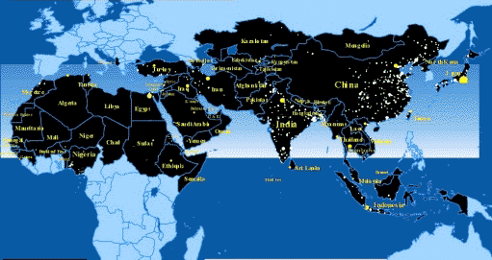
Int’l Students (con’t)
U.S. enrollment coming from
China
India
South Korea
Saudi Arabia*
Notes:
b. 2012 Coming from:
(top 10) China, India, South Korea, Saudi Arabia, Canada, Taiwan, Japan, Vietnam, Mexico, Turkey
huge increases in students from middle eastern countries
many coming from unreached places (10/40)
some coming as missionaries

Slide 8
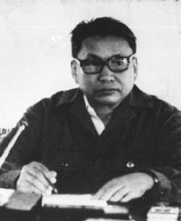
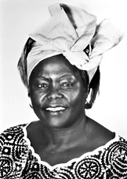
Int’l Students (con’t)
Pol Pot
Wangari Maathai
“B”
Notes:
c. Int’l students are:
brilliant, influential, in transition, capable of great things.
A few quick stories... (brief)
ii. Pol Pot -
intl student in France,1949
from Cambodia
eventually become dictator of Cambodia
led a revolution and genocide killing ~ 2.5 million people.
iii. Wangari Maathai -
intl student in Kansas and Pennsyvania (1960’s)
environmentalist and political activist
began a movement to reforest Kenya ...
by paying poor women to plant trees
1st African woman to receive Nobel Peace Prize for her impact.
iv. My friend “B” from Lindenwood U.
intl student, in my B.S. this year
doesn’t know Jesus yet
wonder what he’ll do when he goes back to his country. ..
The people you posted - I wonder what they will do.
d. Our Response:
think Jesus is asking us to have a part in influencing their story.
Ppl in North America are in a unique position to reach the world around them.

Slide 9
Int’l Students (con’t)
Alumna testimony: Rutendo Chikuku
Notes:
4. Student testimony (5)
Transition: Wanted to hear from intl stu from St. L and hear from their perspective.
What is it like being an international student?
What do you wish North Americans knew about you?

Slide 10
Int’l Students (con’t)
What I wish Americans knew?
Notes:
4. Student testimony (5)
Transition: Wanted to hear from intl stu from St. L and hear from their perspective.
What is it like being an international student?
What do you wish North Americans knew about you?

Slide 11
Int’l Students (con’t)
Okay back to what I wish Americans Knew…
Eager to learn about domestic culture
But must show some interest in their culture also (HUGE!)
Other countries are important too
Culture shock! Extend grace to your international friends
Africa is a continent!!!!
Notes:
4. Student testimony (5)
Transition: Wanted to hear from intl stu from St. L and hear from their perspective.
What is it like being an international student?
What do you wish North Americans knew about you?

Slide 12
Perspective
Film Clip
Notes:
Outsourced Video (3 min) - ?
Show + debrief

Slide 13
Social roles
Group norms
expectations
Concept of self
What has shaped your identity?
religion
External characteristics
customs
History / narrative
Food
Corporate experiences
Language
geography
Notes:
2. Culture Tree (5 minutes)
What do we see / not see in our cultures? Where do they come from?
What has shaped your identity? Your friend’s identity?
Our goal: see how Jesus is relevant to your friends perspective
List some specific differences (shame/honor, etc)

Slide 14
Perspective (con’t)
Understanding perspective
Research
Observe
Befriend
Notes:
3. Understanding perspective- Brian
Research
Observe
Befriend
Understand perspective
Communicate the Gospel
Define and deal with cross cultural differences
Gain trust to speak truth
Caution:
Don’t be fake
Don’t make relationship God

Slide 15
Perspective (con’t)
Workshop: 10 Reasons Jesus came to die
How is the Gospel relevant to
your friend’s culture?
Notes:
4. Workshop: 10 reasons Jesus came to die (2 minutes)
Story of Nic
handout?

Slide 16
*Break Out*
How is your friend’s perspective different from yours?
How do you think that Jesus is relevant to them?
Pray with a friend and ask God to speak!
Notes:
5. **Break Out** (5 minutes)
How is your friends perspective different from yours?
How do you think that JEsus is relevant to them?
Pray with a friend and ask God to speak!

Slide 17
Practicals
To start a cross cultural Bible study
Notes:
Part 3 : Practicals how to start (10 minutes) - Allison

Slide 18
Practicals
Pray!
Find a partner
Assess who
What if I don’t have any international friends or anyone interested in studying the Bible?
Notes:
Pray! (emily praying in china)
Find a partner.
Assess who:
Who you know (Exercise: do a network map analysis)
Research: What do you know about this group? Likes? Hang outs?
Engage in spiritual conversations.
Interest in studying scripture?
What if I don’t have any international friends? Or anyone interested in studying the Bible?
Develop relationship
Praying and finding spaces
Take risks (story: Stephen)
Attend different events. Meet other’s friends.
Do fun stuff together (ex: sports, cultural outings, cooking food together)
Prayer walk.
Pray for open ppl

Slide 19
Practicals (con’t)
Start!
Studying scripture with my international friends
Notes:
5. Start!
Start light and fun.
Intro B.S.
Continue inviting. (story: why did you never invite me?)
Pick material.
Based on participants
Their spiritual needs? Questions?
Notes resources fay come / is coming.
6. Studying Scripture with my intl friends
Be mindful of:
their language, defining words, don’t use Christianese words
Their background (guided/ less guided, oral/written)
their perspective

Slide 20
Practicals (con’t)
Notes:
7. Reminder: Time spent

Slide 21
Practicals (con’t)
Applying scripture
Read from their perspective
Identify relevant / obtainable challenge
Practice with them
Notes:
8. Applying scripture - Learn to pursue Jesus WITH them (Brian) - (5 minutes)
Story - How to practice obedience with friends in Bible study.
Key take aways:
Prayer
Think about their perspective & what would be meaningful to them. (forgiveness, cover shame, expose comparison, serve the poor, show kindness to the outsider, etc.
Do it with them
Resource: Missional application chart

Slide 22
Conclusions
Opportunity on campus
Cultural differences in perspective exist
Need to develop understanding of perspective through relationship
Notes:
Part 4: Conclusions (1 min.) Objectives
Opportunity on campus
Cultural differences in perspective exist,
need to develop understanding of perspective through relationship

Slide 23
Conclusions (con’t)
Where are you at?
Invitation to…
Make international friends
Engage in spiritual conversations
Start a study
Pursue Jesus with your friend(s)
Learn more about a specific population and their perspective
Notes:
Invitation: Where are you at: (8)
Make international friends
Engage in spiritual conversation
Start a study
Pursue Jesus with your friend(s)
Specific population you’re called to - Learn more about their perspective
3. Prayer-minute of silence to listen and see if God’s bringing up something. Share with your partner. Then pray for each other.

Slide 24
Q & A

