Slide 1
Chapter Planting Among Internationals
Brian Chukwu-Smith - Adri Fonteijn - Megan Leong

Slide 2
Chapter Planting Among Internationals
ISM Planting Framework
Best Practices
Workshop

Slide 3
Stage 1 | Stage 2 | Stage 3 | Stage 4
Primary Focus: Finding pMCs, building a missional family 6-10 missional core, 15-25 total 1+ missional group 4-10 pMCs developing 2 apprentices 15 networks accessed Reach 500 faculty/students | Primary Focus: Developing a Core & Experimenting in missional activity 8-15 missional core, 30-50 total 2+ missional groups Marker: Core is trying mission, inviting, and beginning to be apprenticed/lead | Primary Focus: Developing missional leaders 8-20 missional core, 40-60 total Core team expanding influence, sharing leadership & ownership of ministry Students lead GIGs/are engaged in evangelism Expanding network of students form different countries | Primary Focus: Building Increasing quality, variety of outreach, new ethnic groups and departments Key volunteers arise Staff team grows

Slide 4
General
ISM
Stage 1: Forming a Missional Core
8-15 missional core, 15-25 total
2+ missional groups
20 pMCs developing
4 apprentices
15 networks accessed
Reach 500 faculty/students
Primary Focus: Finding Potentially Missional Christians (pMCs) & engaging them in mission
Stage 1: Developing Trust & Forming a Missional Core
6-10 missional core, 15-25 total
1+ missional group
4-10 pMCs developing
2 apprentices
15 networks accessed
Reach 500 faculty/students
Primary Focus: Finding pMCs, building a missional family

Slide 5
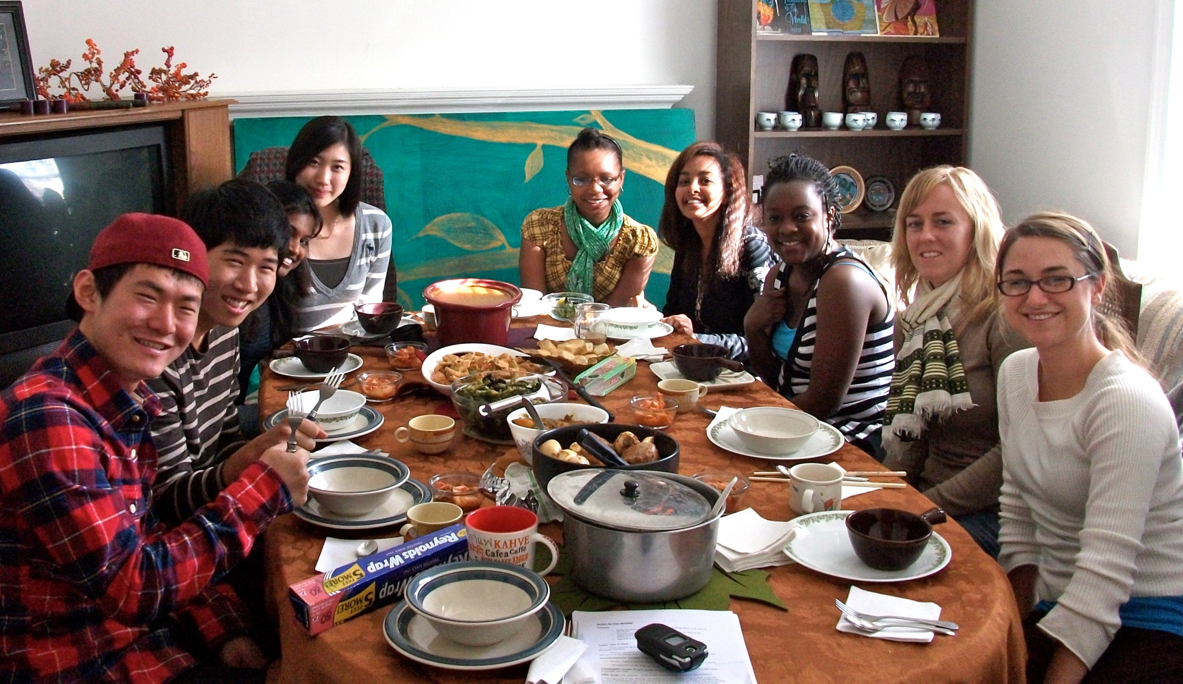
Core Meeting 2nd semester

Slide 6
General Strategy
ISM Strategy
Staff seeks God’s heart & invites people to pray
Vision casting central
Experimentation
Gather pMCs in small group Bible studies & other events to engage in mission
Discipleship Cycles
Each MC can network map & is doing SSN Manuel
Catalytic events
Community expresses vision
Engage non-Christians early on
Weekly large dinner & GIG
Developing trust with pMCs & engaging in low risk discipleship cycles
Network Mapping is verbal
Students need to be apprenticed before starting something new.
Notes:
Examples: Blow up map of campus & have people place themselves on it, other Christians they know, and non-Christians they know, then pray for them.
Small Risk Example: Taking for a prayer walk, having them help with cooking and bring a friend

Slide 7
Discipleship Cycles

Slide 8
General
ISM
Stage 2: Building Momentum
15-30 Missional core, 30-50 total
Primary Focus: Working with a Core Group to advance the chapter’s mission
Stage 2: Building Momentum
8-15 missional core, 30-50 total
Primary Focus: Developing a Core & Experimenting in missional activity

Slide 9
General
ISM
Stage 2 Strategy
Develop prayer-life of core
Core Meetings inspire & train to carry out mission of chapter
Core recognizes networks & invites
Larger NSO launched by core
Select core members experiment with leading small groups
Catalytic events call for commitment
Stage 2 Wave implemented
Stage 2 Strategy
Core Meetings emphasize that family fuels mission
Core Members are apprenticed to lead small groups or helping with leading GIGs in large group.

Slide 10
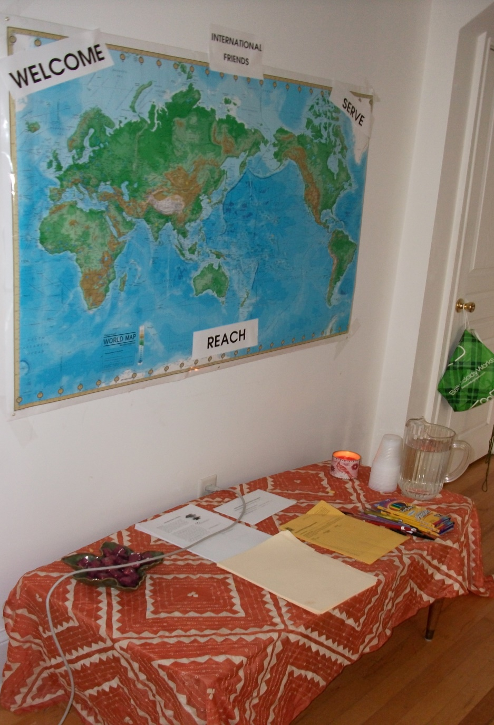
Notes:
Example of Core Meeting: Each week someone gets an opportunity to share their testimony, make something from their country. Pray for that nation. Give examples of mission based around family – no one is left behind. Who is left out in our community? How can we care for them?

Slide 11
Importance of Apprenticeship

Slide 12
ISM best practices
Pray
Prep
Go
Gather
ISM Distinctives
Self care

Slide 13
Pray
Discern
images, songs, scriptures
Partner in prayer
Students,MPD partners, staff, supervisor

Slide 14
Preparing to go
Vision
Language
it matters

Slide 15
Go
Show up & prayer walk
Scout
Note needs of int’ls
Your visit is a live inductive study

Slide 16
Gathering (the “who”)
Looking for
Bridge builders
Informants (insiders)
People of peace

Slide 17
Gathering (the “how”)
Ask for input on structures
Food (double hospitality)
Actions, not titles, give several options
Help students lead each other into encounter

Slide 18
Self care
Peers & mentors
Stuff you can “win” at
High intensity & retreats
Find a coach

Slide 19
Reflect
Where are you in the planting stage?
What are you currently struggling with in planting? What road blocks or obstacles exist?

Slide 20
Stage 1 | Stage 2 | Stage 3 | Stage 4
Primary Focus: Finding pMCs, building a missional family 6-10 missional core, 15-25 total 1+ missional group 4-10 pMCs developing 2 apprentices 15 networks accessed Reach 500 faculty/students | Primary Focus: Developing a Core & Experimenting in missional activity 8-15 missional core, 30-50 total 2+ missional groups Marker: Core is trying mission, inviting, and beginning to be apprenticed/lead | Primary Focus: Developing missional leaders 8-20 missional core, 40-60 total Core team expanding influence, sharing leadership & ownership of ministry Students lead GIGs/are engaged in evangelism Expanding network of students form different countries | Primary Focus: Building Increasing quality, variety of outreach, new ethnic groups and departments Key volunteers arise Staff team grows

Slide 21
Case studies
As a table group read and answer the following questions:
In what stage is this plant?
Describe the problem.
What are the components that contribute to the problem?
What would be the desirable outcome?
Give one or multiple ways to move towards the desirable outcome.
Highlight the problems and give your recommendation(s) to the large group.

Slide 22
Your campus
Share your problem to your table group, include:
What type of campus are you on?
Where are you in the planting stage?
What is the road block / problem you're running into?
Work together to create a potential plan of attack moving forward.

Slide 23
Chapter Planting Among Internationals
Brian Chukwu-Smith - Adri Fonteijn - Megan Leong

Slide 24
In case you need the logo…

Slide 26
Georgia (italic, not bold)
Frutiger LT 45 Light
Green = Red:114 Green:191 Blue:68
All other text is a dark blue:
Red:0 Green:31 Blue:73
Some accent orange = Red:253 Green:185 Blue:19
If you don’t have Frutiger you can download it here (http://2100.intervarsity.org/resources/frutiger-font)

